Slide 1

LG SMART FRIDGE
Matthew Walcher & Caitlyn O’Driscoll

Slide 2
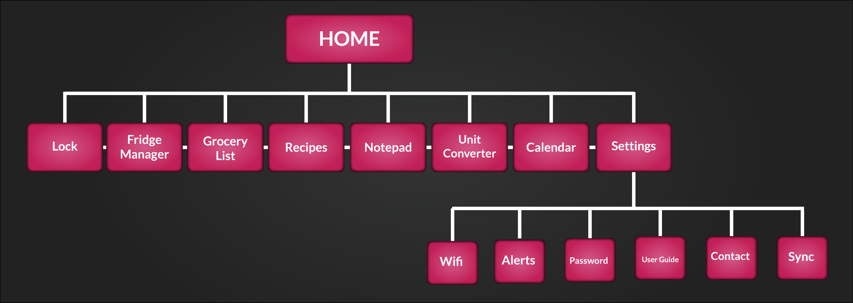
Flow Chart
Matthew Walcher & Caitlyn O’Driscoll

Slide 3
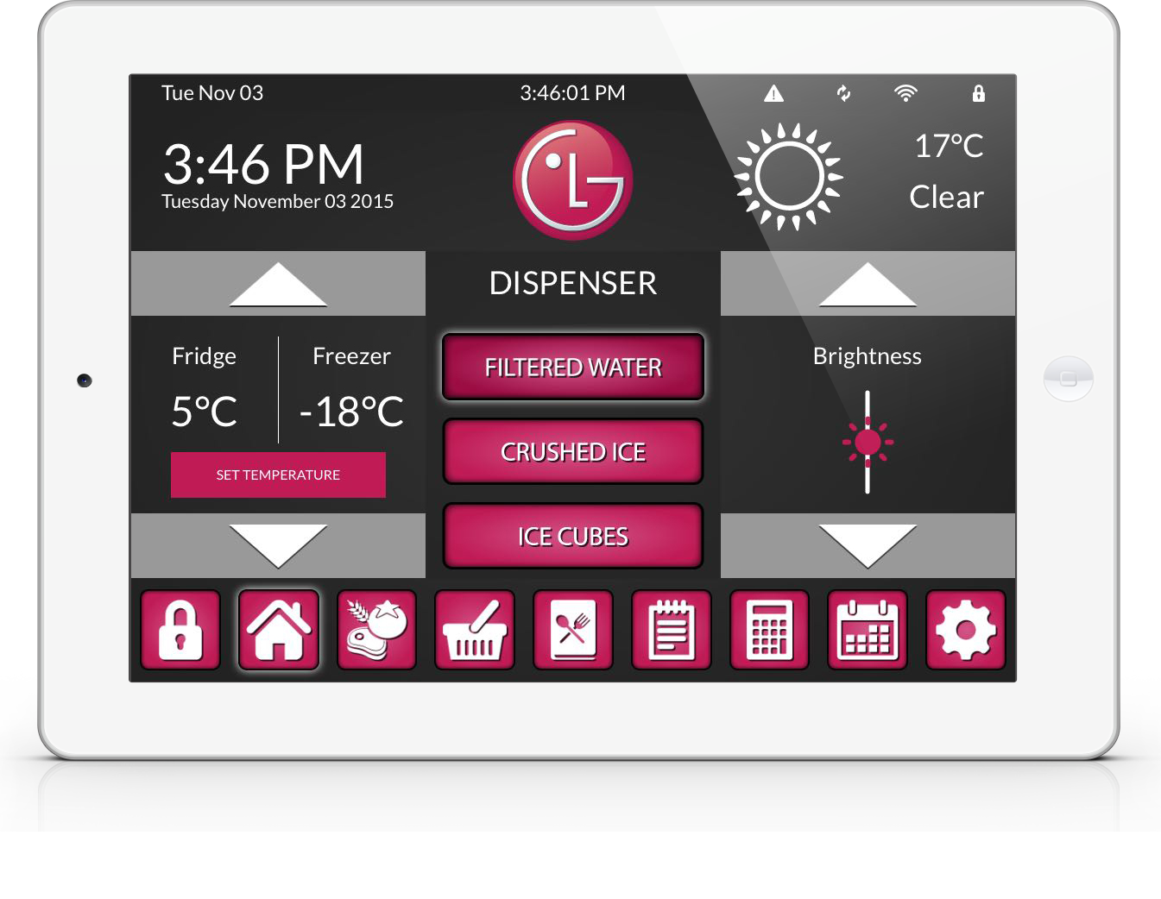
Home
Matthew Walcher & Caitlyn O’Driscoll

Slide 4
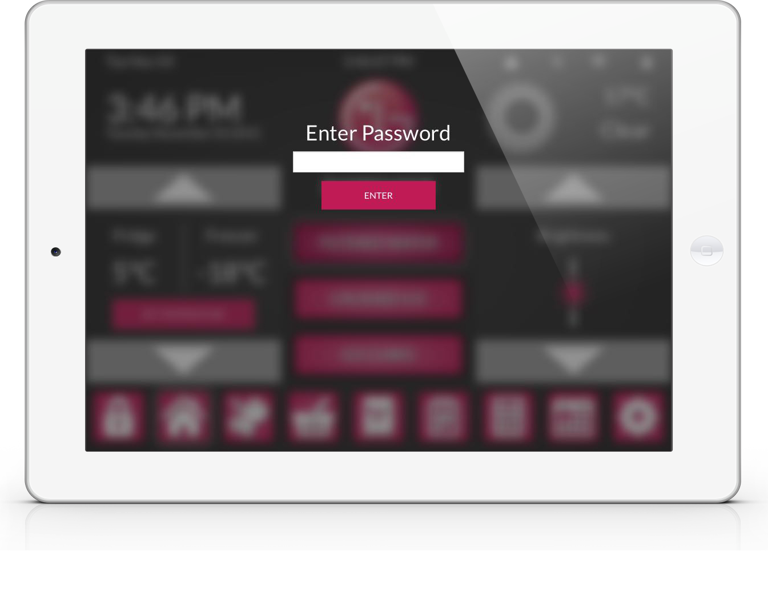
Lock
Matthew Walcher & Caitlyn O’Driscoll

Slide 5
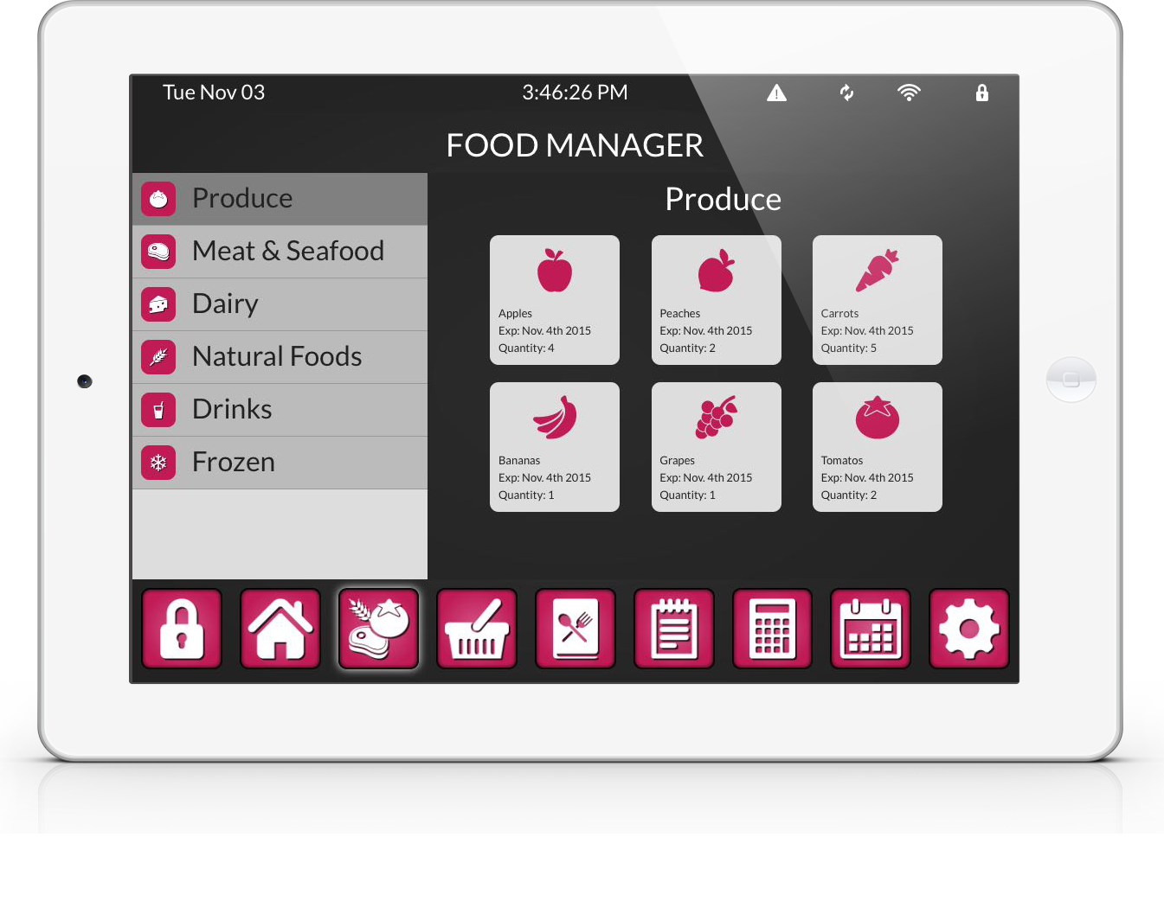
Food Manager
Matthew Walcher & Caitlyn O’Driscoll

Slide 6
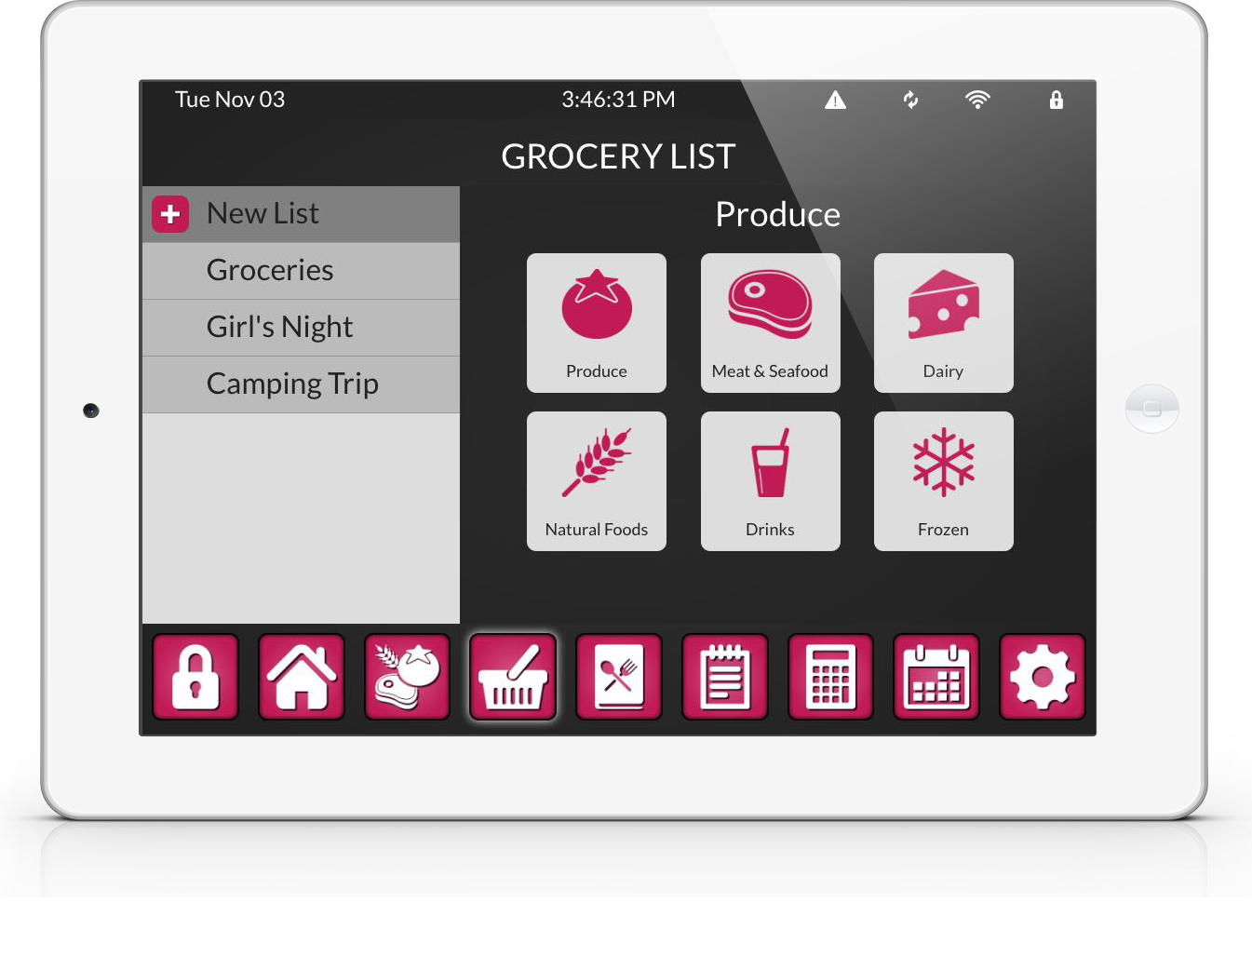
Grocery Lists
Matthew Walcher & Caitlyn O’Driscoll

Slide 7
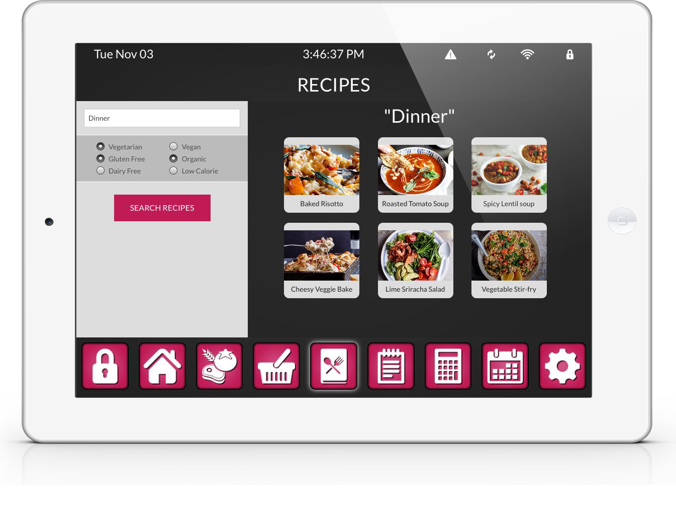
Recipes
Matthew Walcher & Caitlyn O’Driscoll

Slide 8
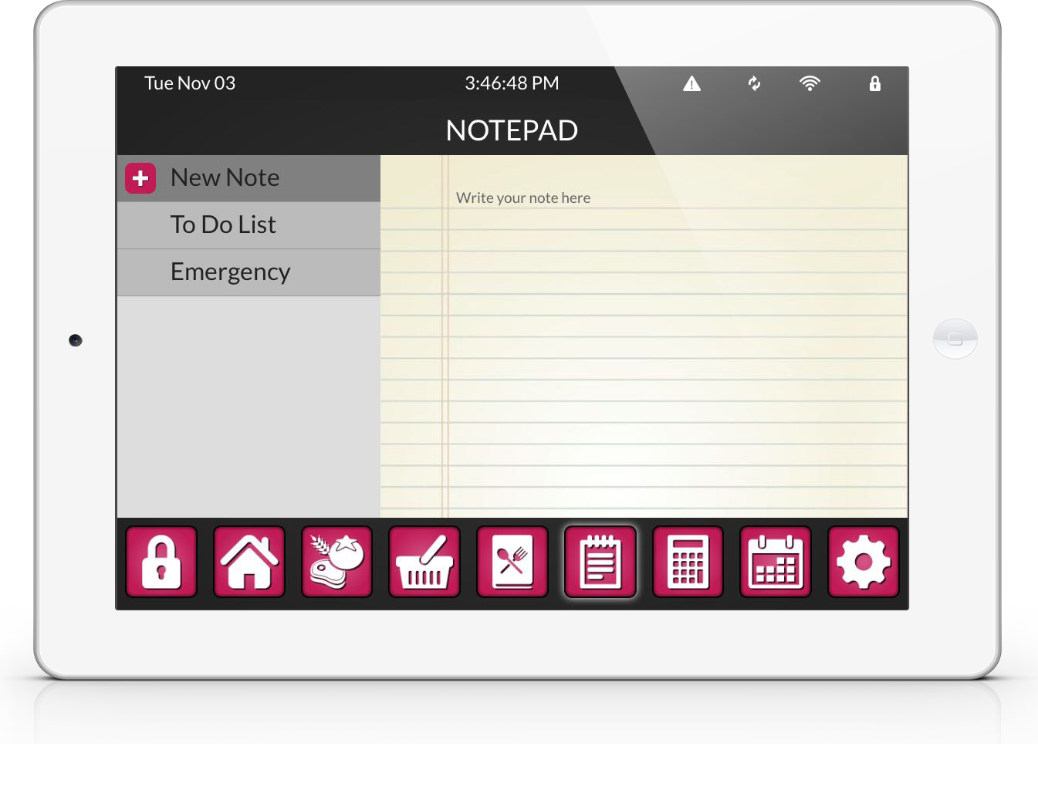
Note Pad
Matthew Walcher & Caitlyn O’Driscoll

Slide 9
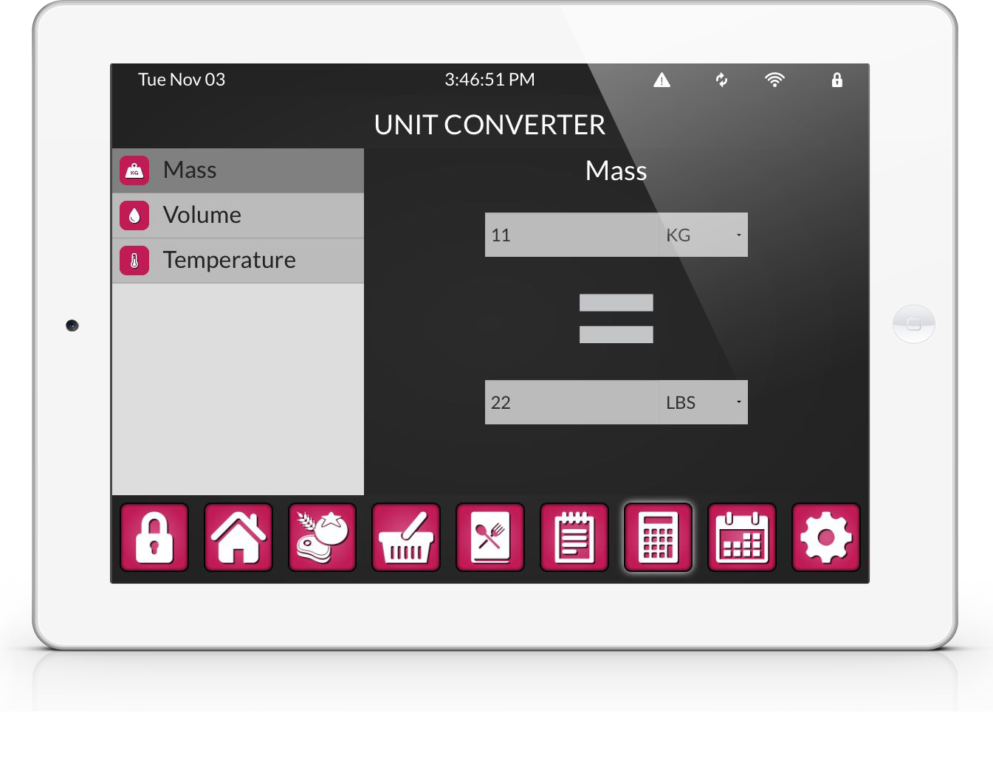
Unit Converter
Matthew Walcher & Caitlyn O’Driscoll

Slide 10
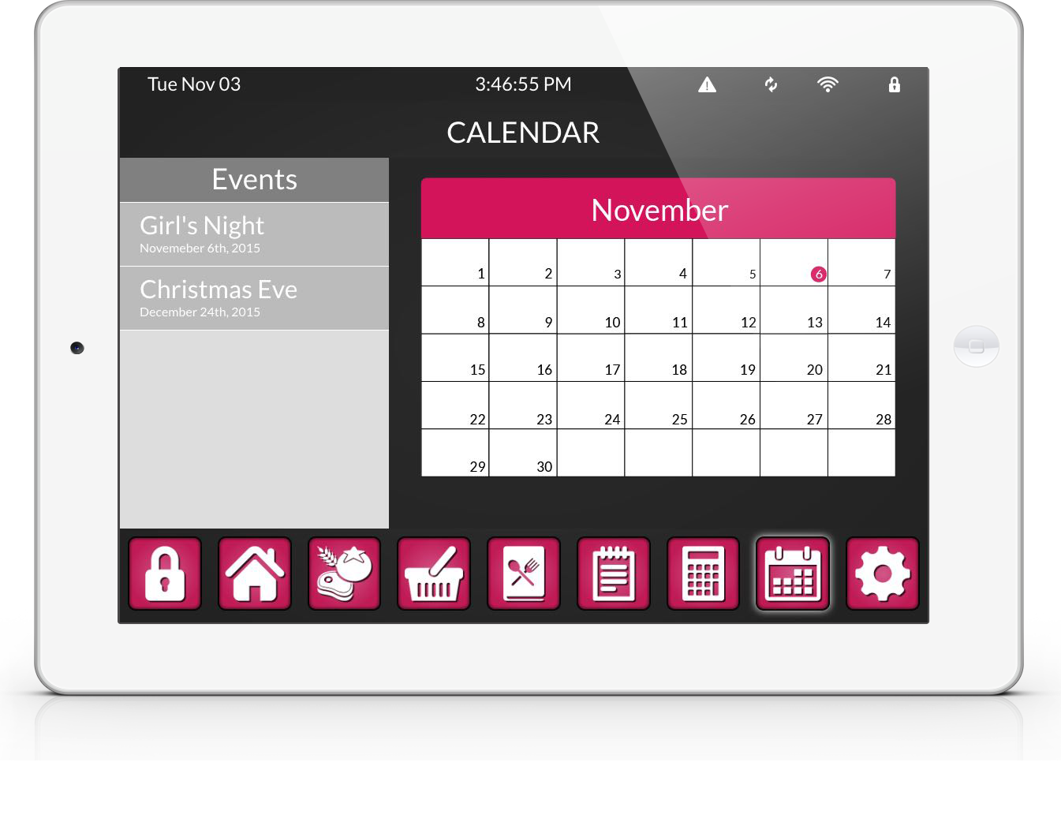
Calendar
Matthew Walcher & Caitlyn O’Driscoll

Slide 11
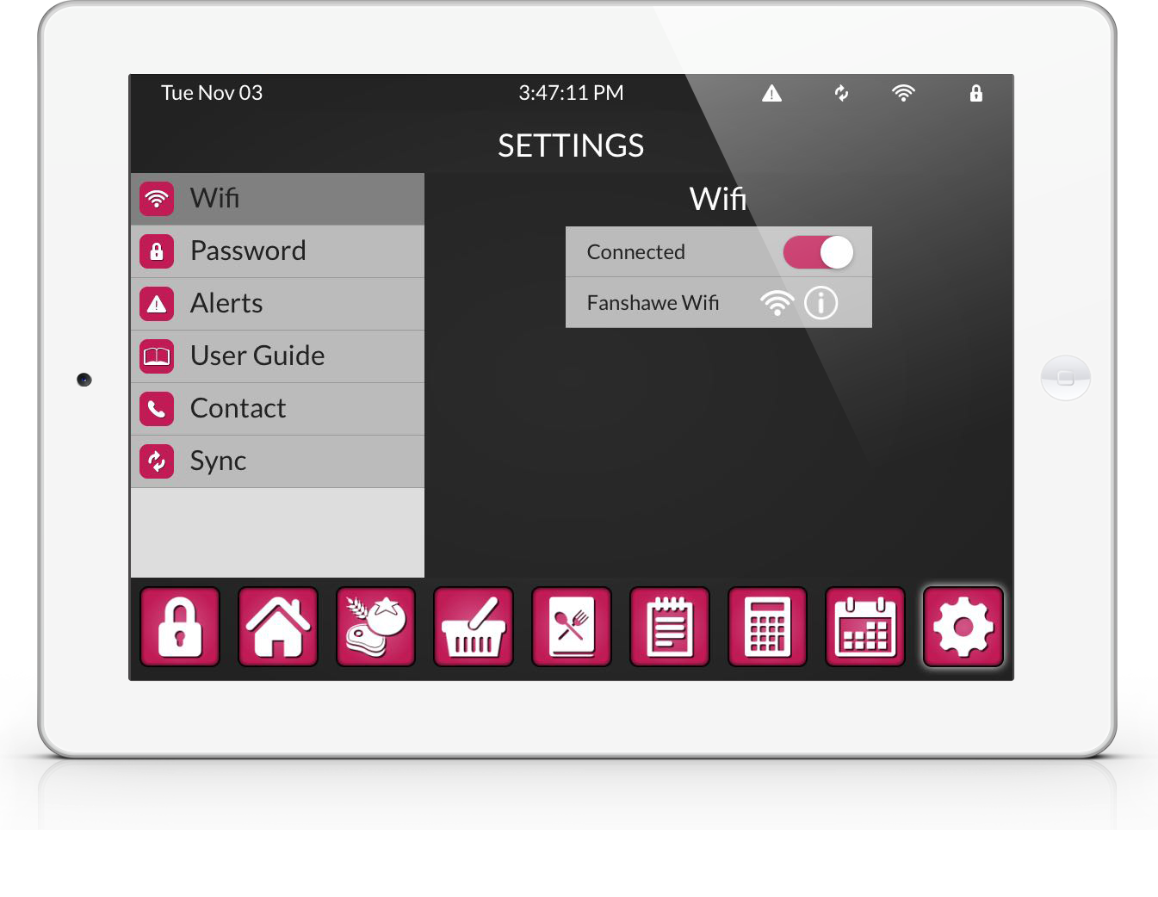
Settings
Matthew Walcher & Caitlyn O’Driscoll

